Slide 1
Lab #4: Build K-unitigs from K-mers
Lab #4: Due Friday October 24. The goal for Lab #4 is to write code that parses reads in fastq file, counts canonical K-mers for a given K, and then builds K-unitigs – unique non branching paths of K-mers in a K-mer graph. K-unitigs are genomic sequences. All K-mers in the reads must be present in K-unitigs. Each K-mer of size K must be in only one K-unitig.
Reads are provided in autograder as “read1.fq”. You can assume that this file is in your current directory. Reads are also available on github for testing: https://github.com/alekseyzimin/BME-Algorithms-for-Analysis-of-Genomic-Data/raw/refs/heads/main/read1.fq
Write the following functions in python:
(g:10/u:10) reverse_complement(seq) – returns reverse complement of sequence seq
(g:10/u:10) canonical_kmer(kmer) – returns canonical version of the k-mer kmer using lexicographic order
(g:10/u:20) count_canonical_kmers(file.fastq,k) – reads genome sequences from file.fastq, returns dictionary kmer_counts[kmer]=count for K-mer size k
(g:10/u:20) compute_n50(sequences) -- returns N50 of sequences in the input array sequences
(g:40/u:40) build_unitigs(kmer_counts) – returns array of k-unitig sequences, argument is dictionary kmer_counts produced by count_canonical_kmers
Graduate section only(g:20): run compute_n50(build_unitigs(count_canonical_kmers(fastq_path,k))) code varying K-mer size between 15 and 90, and submit a plot of how K-unitigs N50 varies with K. At which K value the N50(K) is the largest? Add the value in a text box to the plot.

Slide 2
K-unitigs
K-unitigs are uniquely assemble-able paths of K-mers connected with K-1 exact overlaps
Paths must not contain any branches in forward or reverse direction
Pick a canonical K-mer, check if it has been used in a path before, and if not, extend uniquely forward and backward checking for branches
Stop extension if a forward or backward branch detected

Slide 3
Forward branch
Start with AGACA check continuation to the right. What are the possible continuations of GACA ? GACAC AGACA GACAG none A
This is a “forward branch”. K-1 mer on the right GACA has two possible extensions. Do not extend.

Slide 4
K-mer graph
Can we extend K-mer GACAC to the left even if continuation is unique? GACAC AGACA C no GACAG
G no T no A
GACAC cannot be extended to the left because of a “backward branch”, since the continuation of GACA to the right is not unique

Slide 5

K-unitigs
This graph contains five K-unitigs (black lines)
K-1 overlap
K-1 overlap

Slide 6
Genome assemblers
Hifiasm -- for PacBio HiFi or ONT, can use HiC to resolve haplotypes, uses string graph, error corrects reads uses perfect long overlaps
Flye -- for Oxford Nanopore (and PacBio hifi), uses string graph
Verkko – can produce T2T assemblies uses PacBio HiFi+ONT data, high coverage requirements
MaSuRCA -- for hybrid data sets – uses both K-mer graph (super-reads) and OLC/String graph
YaHS – for scaffolding assemblies with HiC reads

Slide 7
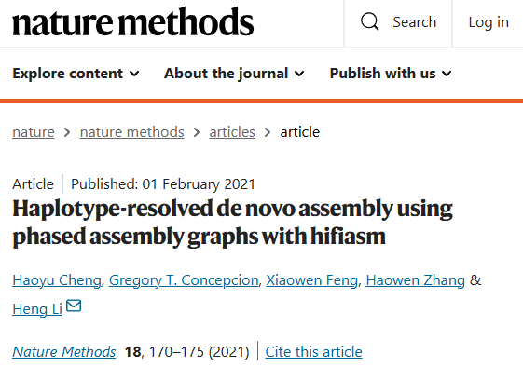
Hifiasm
Used for PacBio HiFi data or the latest (R10.4) ONT data (beta)
Can do haplotype-resolved assemblies with HiC data
Fast and accurate
Error corrects reads, uses string graph with exact overlaps
Can produce assemblies with T2T chromosomes
Outputs assembly in graph format (.gfa)
Use gfatools to output fasta:
gfatools gfa2fa in.gfa > out.fa

Slide 8
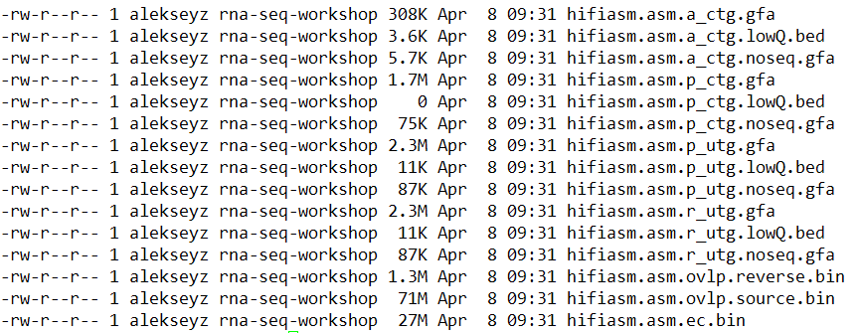
Hifiasm
Outputs:

Slide 9
Hifiasm
Overlaps and error corrected reads; computing these files takes the most time. You can keep them to quickly rerun with different parameters.

Slide 10
Hifiasm
Raw uniquely assemble-able contigs (unitigs), with small bubbles

Slide 11
Hifiasm
Primary uniquely assemble-able contigs (unitigs), without small bubbles

Slide 12
Hifiasm
Primary contigs

Slide 13
Hifiasm
Alternative contigs

Slide 14
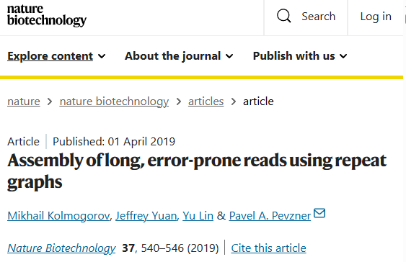
Flye
Assembly of Pacbio CLR/HiFi, ONT reads
Not haplotype-aware
Uses string graph
Can assemble metagenomic data sets
Slower than Hifiasm
Assemblies of high-error reads (PacBio CLR or ONT) need to be polished

Slide 15
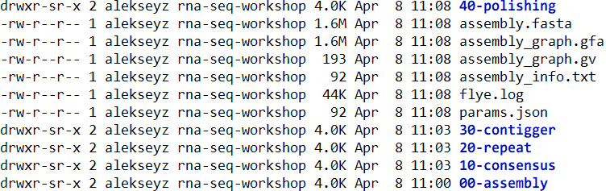
Flye
Outputs:
Assembled scaffolds
Assembly log, information about the assembly

Slide 16
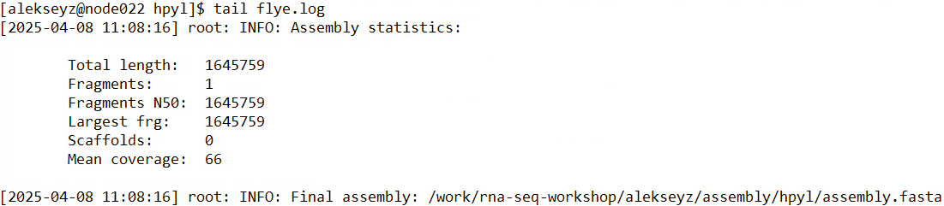
Flye
Outputs:

Slide 17
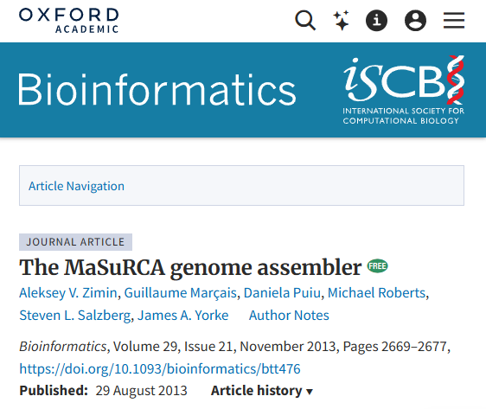
MaSuRCA
Originally designed for short Illumina reads
Enables hybrid assembly, ONT + Illumina, or PacBio CLR + Illumina
Requires Illumina data
Can assemble mega-genomes (20Gbp +)

Slide 18
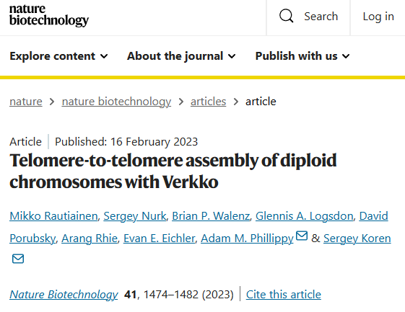
Verkko
Assembly of hybrid PacBio HiFi/ONT ultralong data
Can use HiC data for haplotype resolution/scaffolding
Builds assembly graph from error corrected HiFi reads, resolves with ONT ultralongs and HiC
High coverage requirements: ~50x PacBio HiFi, ~50x ONT ultralongs
Can produce assemblies where many chromosomes are T2T

Slide 19
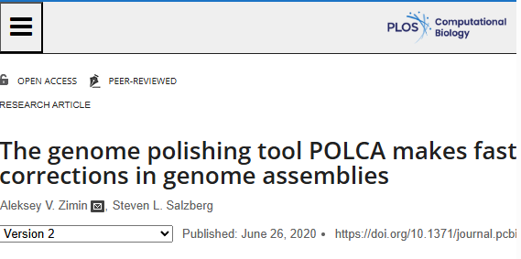
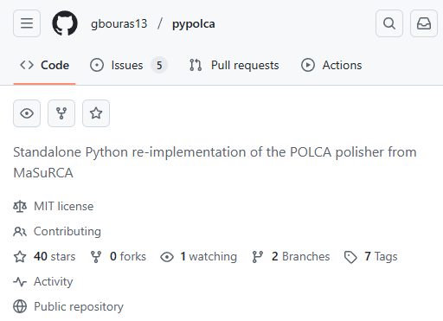
MaSuRCA - POLCA
Polishing tool to fix errors in contigs
Can be used for variant calling (convenient!)
Evaluates contig sequence quality
Distributed with MaSuRCA assembler
Has been re-implemented in Python as pypolca

Slide 20
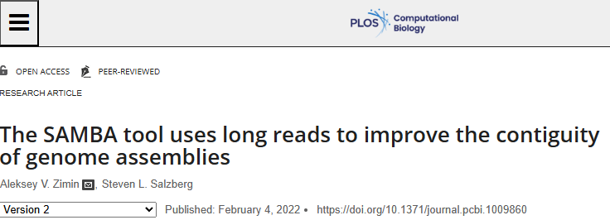
MaSuRCA - SAMBA
Scaffolding tool to improve contig sizes with long reads (ONT/PacBio)
Can be used to improve assemblies with additional data without complete re-assembly
Can be used to close gaps in scaffolds

Slide 21
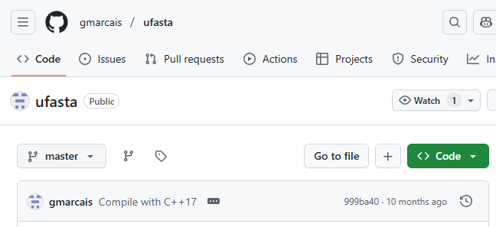
MaSuRCA - ufasta
Multi-purpose tool to work with fasta files
Extract records by name, random sample
Reverse complement
Format
Compute statistics
N50
Averages
E-size
Count

Slide 22
MaSuRCA - ufasta
ufasta can take input from file or pipe
ufasta usage:
Compute N50, total sequence, fragment counts: ufasta n50 -a, –NXX, –S, –C
Extract sequences: ufasta extract -f names.txt, –n single_name, -v
Format file: ufasta format
Make every sequence int one line: ufasta one
Reverse complement: ufasta rc

Slide 23
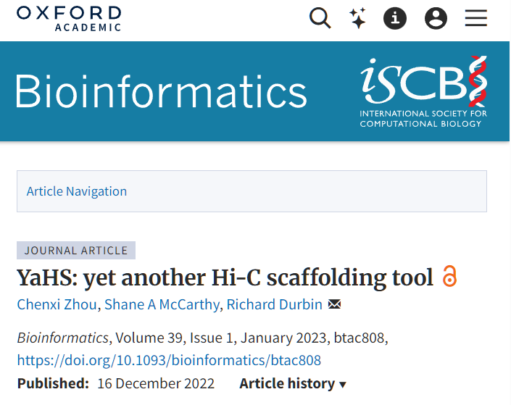
YAHS scaffolder
Uses HiC data to scaffold contigs into chromosome-sized scaffolds
Requires very contiguous assembly (N50 contig > 500K bp)
I recommend using modified fork from my github: https://github.com/alekseyzimin/yahs

